Slide 1


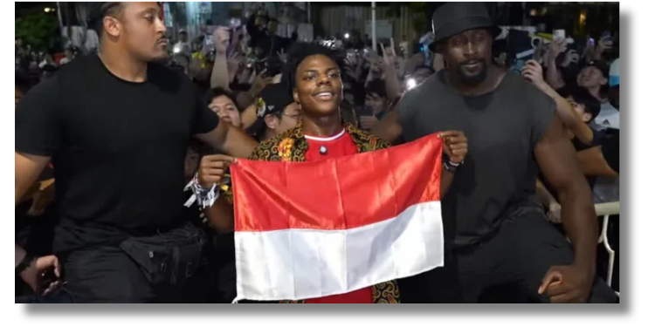
Analisis Jejaring Sosial
PUBLIC SENTIMENT ANALYSIS ON SPEED’S ARRIVAL IN INDONESIA
Imran Abu Libda (D121211105)
Fahriza Gymnastiar L (D121211042)

Slide 2
Introduction
Objective
The goal of this project is to perform sentiment analysis on Twitter posts related to the arrival of the famous YouTuber IShowSpeed in Indonesia. By analyzing the tweets, we aim to understand public opinion surrounding this event

Slide 3
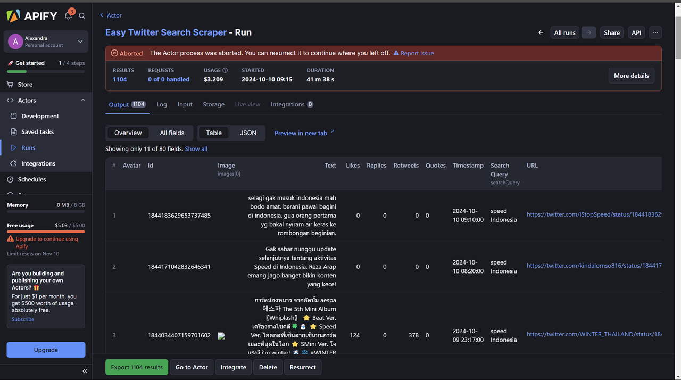

Data Scrapping
Using Apify:
Gather tweets related to Speed's arrival using hashtags or keywords such as #Speed #SpeedIndonesia, #SpeedArrival, , #NontonSpeed, and more using web scraping.

Slide 4
DATA PREPROCESSING

Slide 5
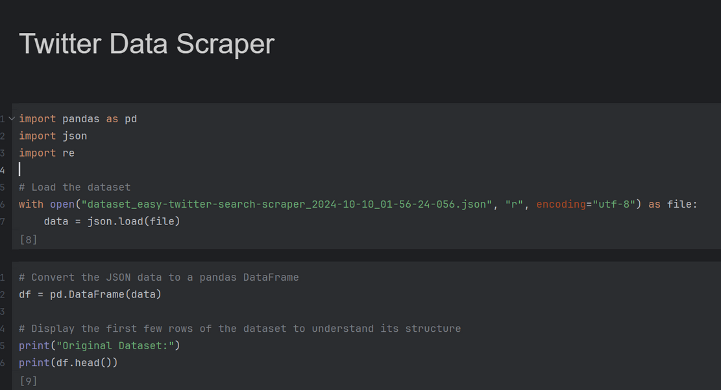
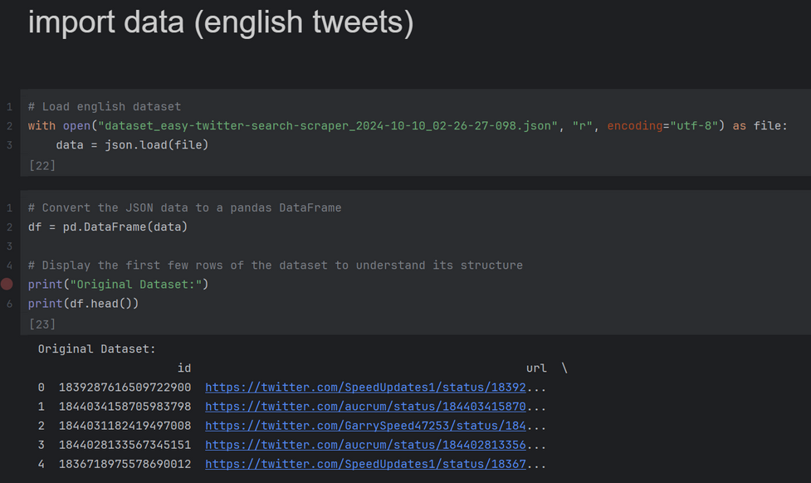
Loading the Data
The dataset was loaded using the pandas library, which provides powerful data manipulation capabilities. For this project, a CSV file containing Twitter data.

Slide 6
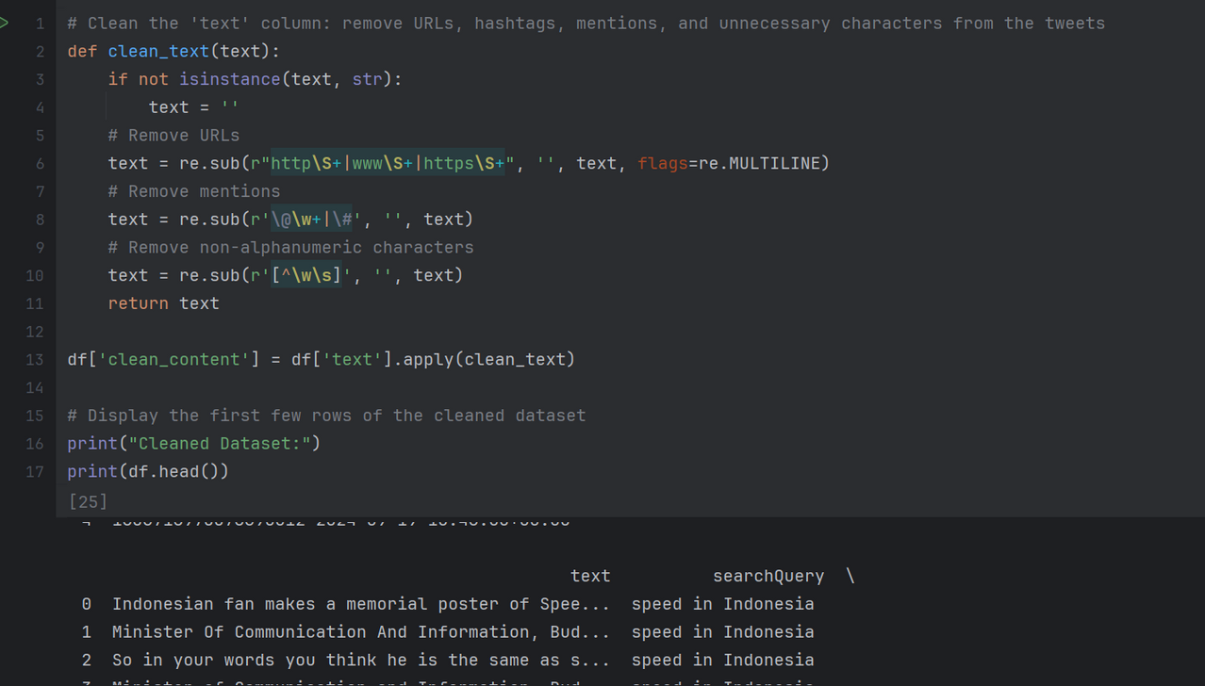
Cleaning the Data
To prepare the data for sentiment analysis, we implemented a clean_text function that removes unnecessary elements from the text to focus on meaningful content. This function cleans the data by removing URLs, which could add noise, and strips away non-alphabetic characters and numbers, ensuring that only relevant words remain. Additionally, user mentions and hashtags are excluded, as they don’t contribute directly to the sentiment of the tweets. By applying this function, we create a cleaned version of the tweet content, making it more suitable for sentiment analysis.

Slide 7
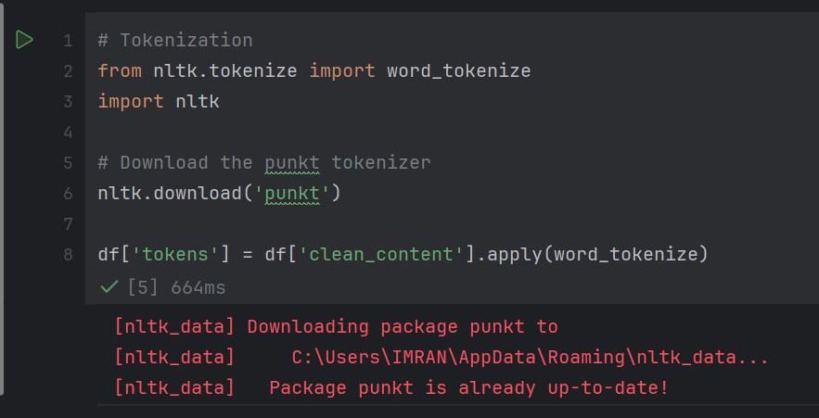
Tokenization
We used tokenization to break down the cleaned text into individual words (tokens), which is a key step for further analysis. The NLTK library was used to perform this process, allowing us to handle each word separately for more detailed sentiment analysis.

Slide 8
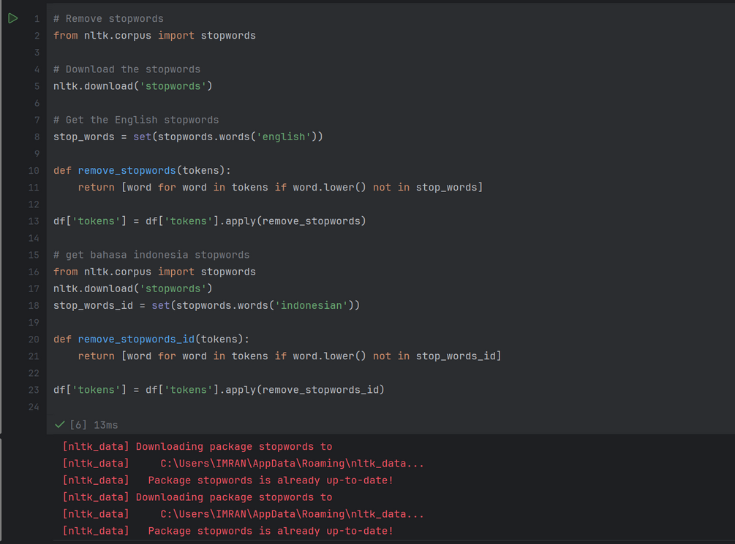
Stopword Removal
We removed stopwords, which are common words like "and" or "the" that don't add much meaning to the text. By filtering them out, we can focus on the more important words for sentiment analysis. Both English and Indonesian stopwords were removed using the NLTK library for more accurate results.

Slide 9
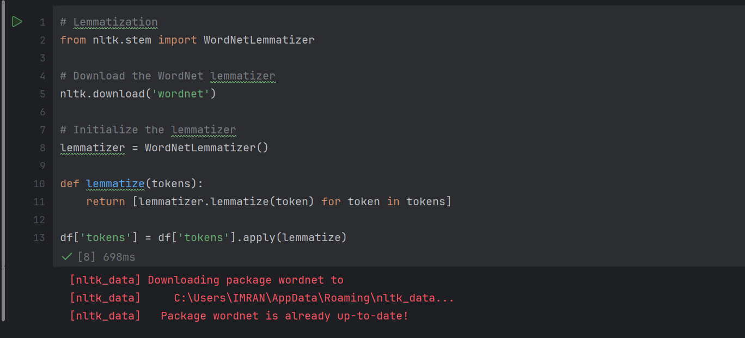
Lemmatization
Lemmatization was used to convert words to their base or root form, so different forms of the same word are treated as one. For example, "running" and "run" are considered the same, which helps in improving the accuracy of the sentiment analysis. This was done using the NLTK library's lemmatizer function.

Slide 10
SENTIMENT ANALYSIS

Slide 11
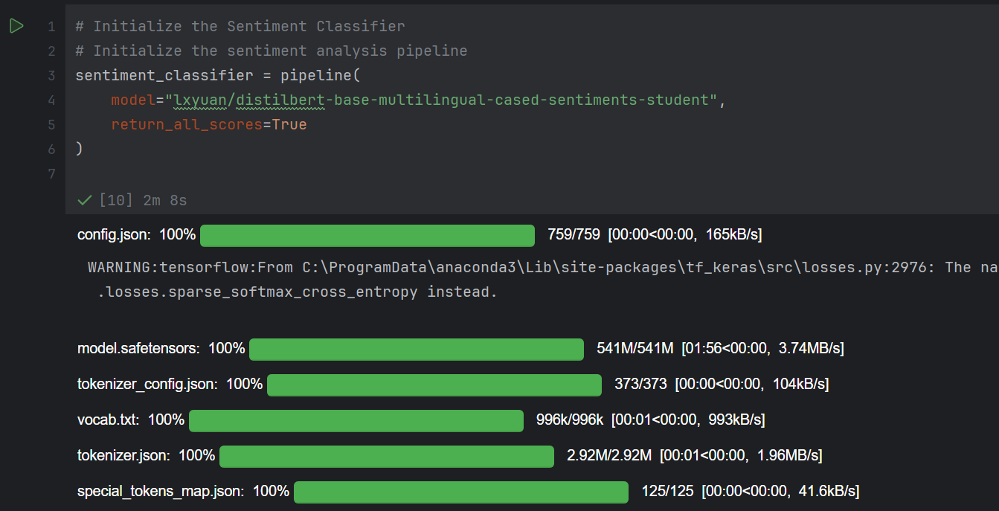
Model Initialization
For sentiment analysis, a pre-trained model from the Transformers library was initialized. This model is capable of handling multiple languages, making it suitable for analyzing sentiment in both English and Indonesian tweets. The model used was "lxyuan/distilbert-base-multilingual-cased-sentiments-student", allowing for a comprehensive understanding of the sentiments expressed in the posts.

Slide 12
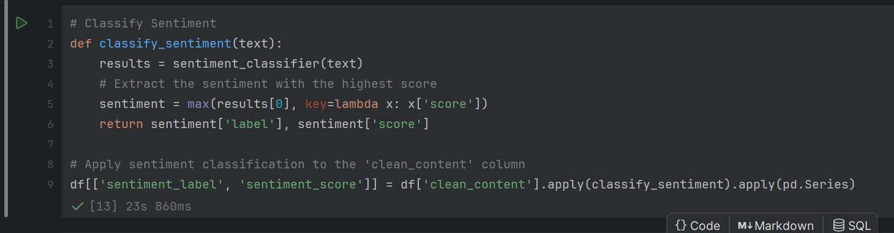
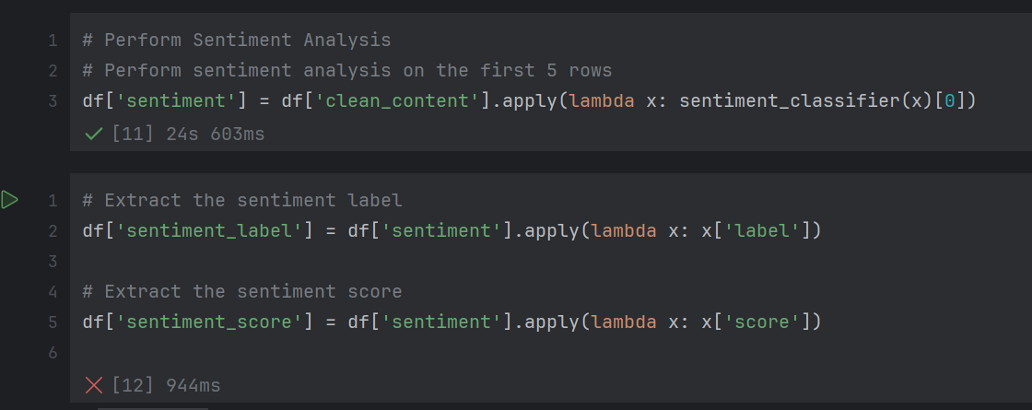
Performing Sentiment Analysis
The sentiment analysis was conducted on the cleaned tweets. For each tweet, the sentiment classifier was applied to determine the sentiment score.
This step provides a sentiment label for each tweet, indicating whether the content is positive, negative, or neutral.

Slide 13
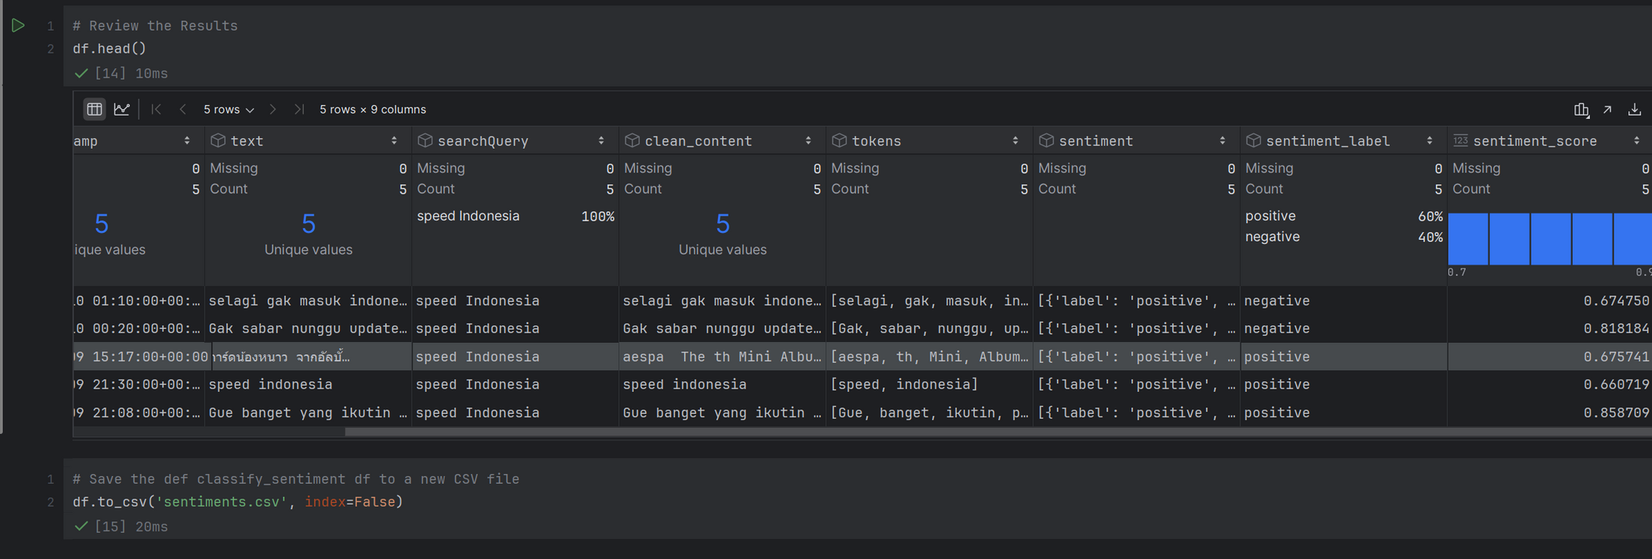
Results Extraction
The sentiment labels and their corresponding scores were extracted from the analysis for each tweet. This allows us to categorize the sentiment as positive, negative, or neutral, along with the confidence score for each label.
This provides the foundation for analyzing the sentiment trends in the dataset.

Slide 14
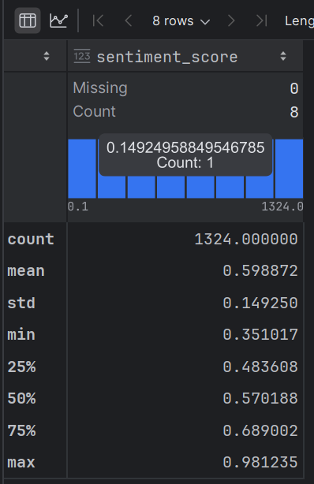
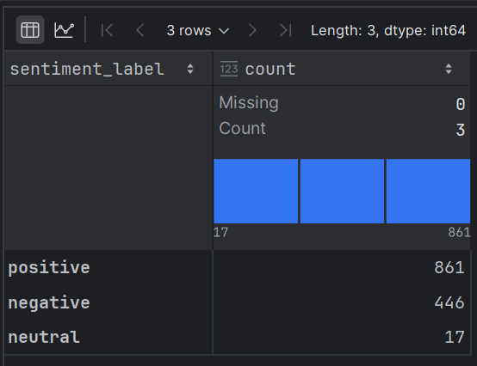
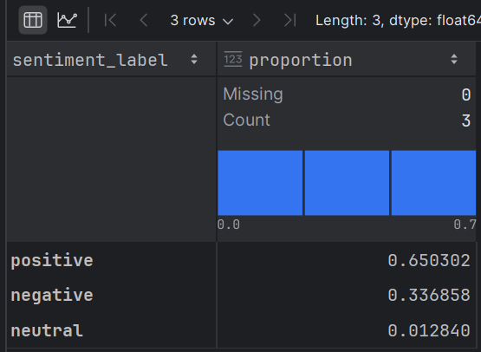
Data Analysis
In the sentiment analysis related to IShowSpeed's arrival in Indonesia, the following distribution was found:In the sentiment analysis related to IShowSpeed's arrival in Indonesia, the following distribution was found:
Positive: 861 tweets (63%)
Negative: 446 tweets (33%)
Neutral: 17 tweets (1%)
From this data, it can be seen that the majority of the public showed a positive reaction to IShowSpeed's arrival, while the number of negative reactions was also quite significant. Neutral sentiment is very low, indicating that most opinions tend to focus on clear views, both positive and negative.

Slide 15
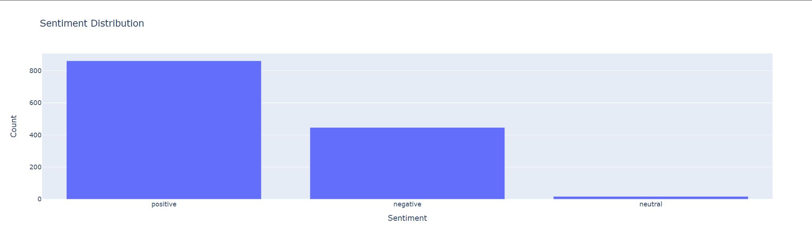
Data Visualization

Slide 16
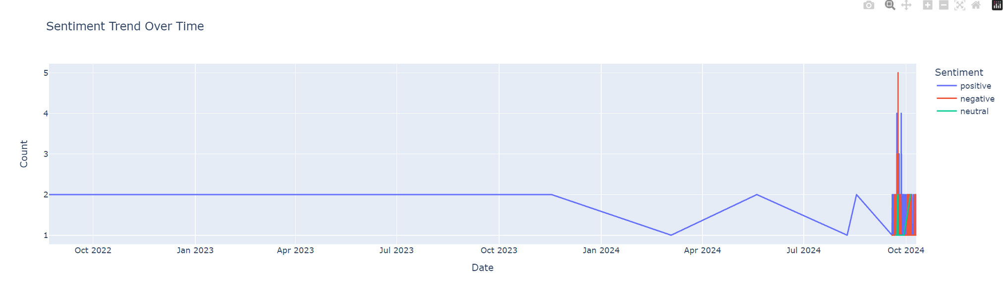
Data Visualization

Slide 17
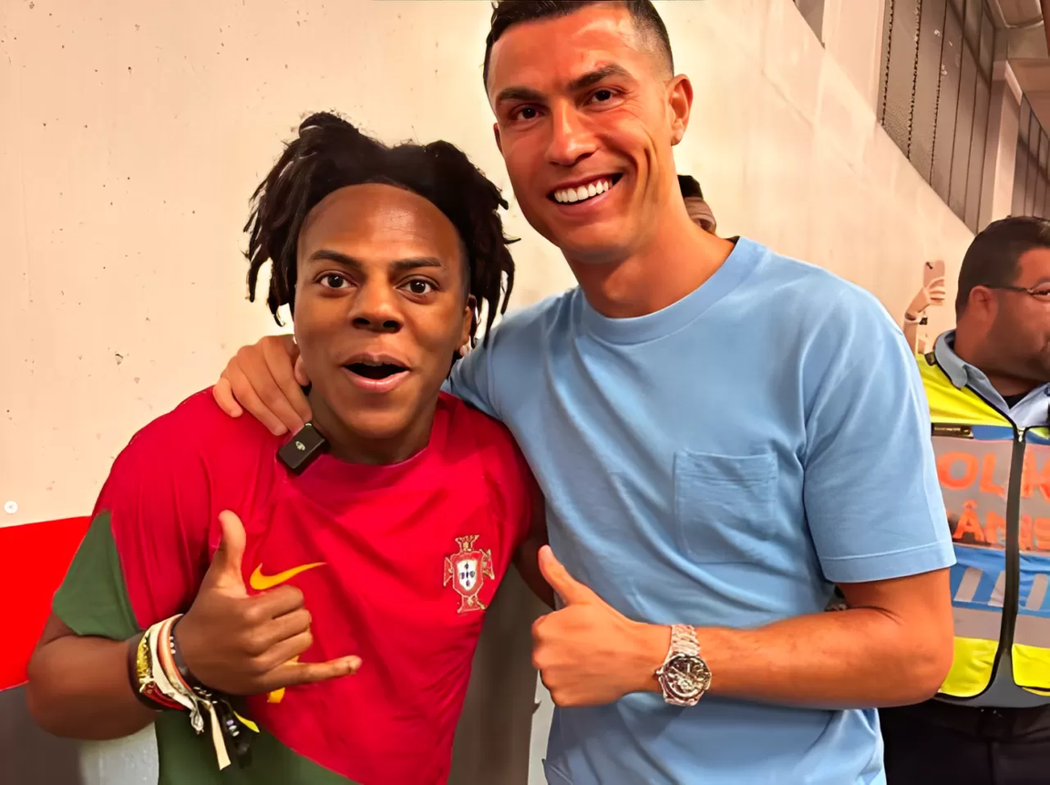
The Final Result Is People Likes Speed

Slide 18
Thank You

